Slide 1

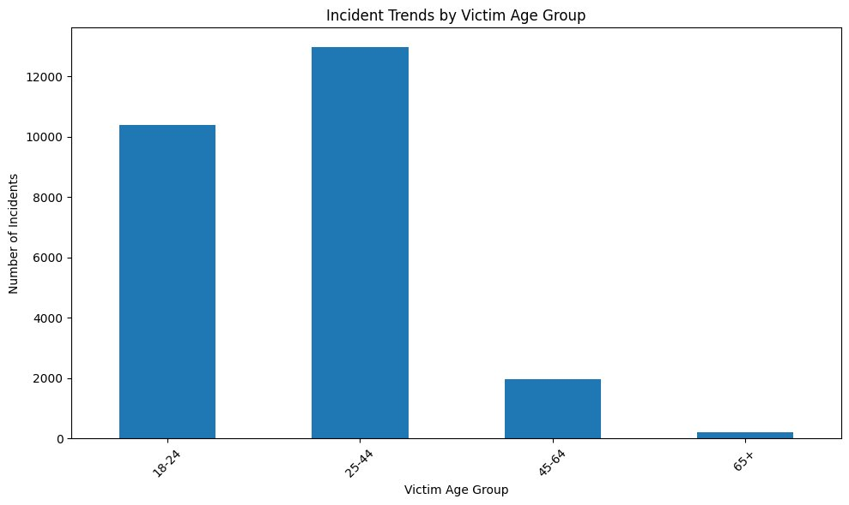
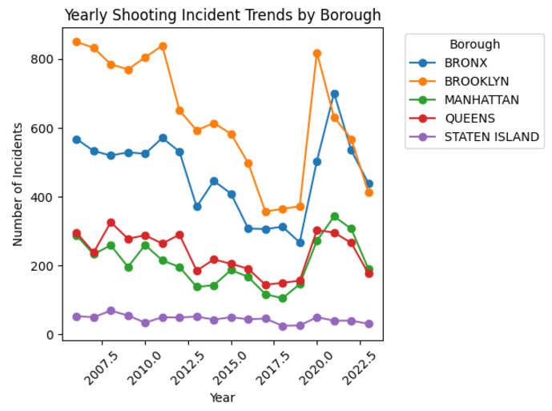
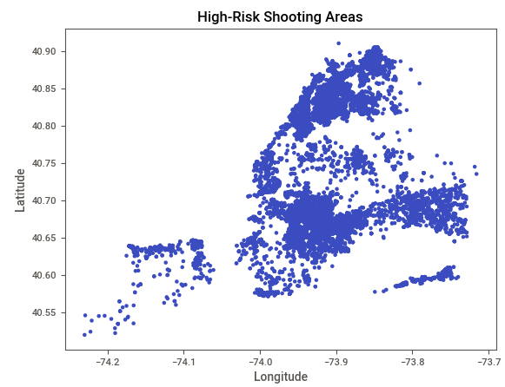
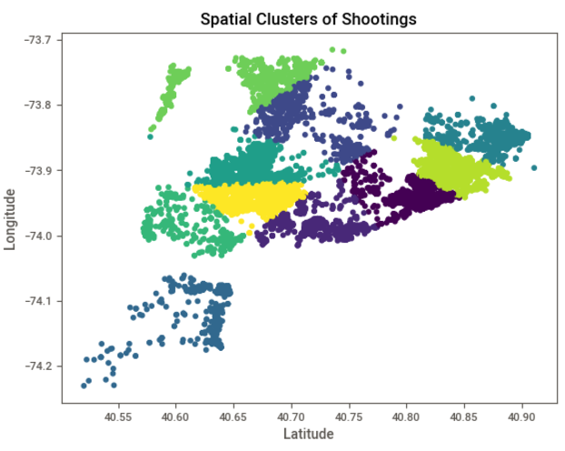
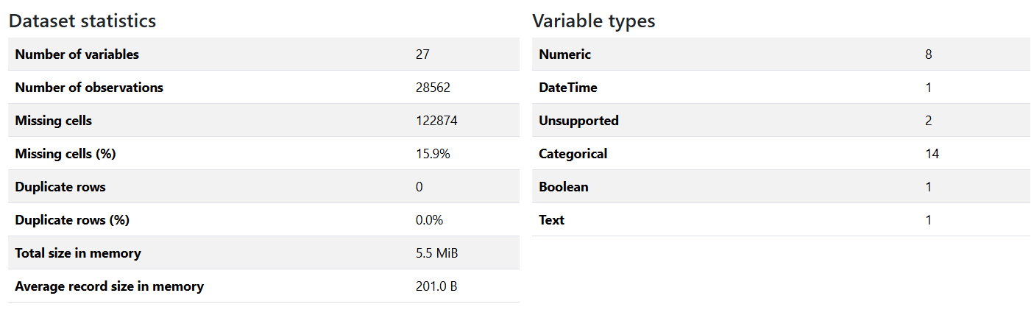
NYC Gun Violence(HISTORIC: 2006-2023)​​
By TejaLakshmi Gangadhar Chalumuri
Mentor: Dr. Christelle Scharff | Pace University
GitHub : https://github.com/TejaChalumuri/cs-668
Code file: https://github.com/TejaChalumuri/cs668/NYCGunViolence(HISTORIC2006-2023).ipynb
Abstract
The current research explores the following: (1) the spatial and temporal patterns of gun violence in New York City's urban neighborhoods from 2006 to 2023. By utilizing a dataset on the shooting incidents obtained from the NYPD Historical Shooting Incidents, the research (2) applies EDA and machine learning methods to investigate the trend, locate high-risk zones, and present demographic distribution of the affected population. Results indicated (3) distinct temporal patterns in shooting incidents, with certain neighborhoods and demographic groups disproportionately affected. Finally, (4) the study concludes that leveraging data-driven insights can inform targeted interventions and recommends integrating predictive analytics to enhance urban safety initiatives.
Methodology
The dataset, loaded from a CSV file, contains NYC shooting incident data from 2006 to 2023.
Initial steps include checking for missing values, examining data types, and generating summary statistics to assess data quality and structure.
Temporal fields like OCCUR_DATE and OCCUR_TIME are converted into datetime formats to facilitate time-based analysis.
Additional temporal features such as year, month, and day of the week are created from the occurrence date to support trend and seasonality analysis.
Yearly Trends: The number of incidents is aggregated by year to identify long-term trends in gun violence.
Monthly Trends: Monthly incident counts are analyzed within each year to reveal seasonal or periodic fluctuations in shooting incidents.
Borough Distribution: The dataset is grouped by boroughs to understand geographic distribution, identifying areas with higher incident rates.
Victim demographics, including age group and gender, are explored to highlight which groups are most affected by gun violence.
Experiment
Choosing algorithms suitable for time-series prediction or classification, such as logistic regression, random forest, or gradient boosting.
Splitting the data into training and testing sets, training the model, and evaluating its performance.
Assessing the model using metrics such as accuracy, precision, recall, F1-score for classification models, or RMSE for regression models.
Research Questions
Exploring Gun Violence Patterns and Impacts
How has gun violence fluctuated annually, seasonally and by neighborhood in NYC?
Which neighborhoods and demographics are most affected by gun violence?
Are there particular times and places where shootings are more likely to occur?
Related Work
The authors in this regard analyze spatio-temporal patterns of violent injury in Toronto utilizing geographic information systems (GIS) and establish that injuries are mainly sustained in underprivileged areas but the frequency is more during the night when there are active areas like night clubs. [1]
Research conducted in Buffalo concerning the impact of COVID -19 on shooting violence indicates that there was. ‘An increase in shooting incidents; emphasizes regions of high risk despite public order being disrupted. [2]
Dataset
Data Link:https://data.cityofnewyork.us/Public-Safety/NYPD-Shooting-Incident-Data-Historic-/833y-fsy8/about_data
Description: Contains shooting incidents from 2006 to 2023 across NYC.
Size: Over 20,000 records with various incident details. The dataset contains of 28562 rows × 25 columns.
Key Variables: Date, borough, location type, victim and perpetrator demographics.
Observations: Some columns have significant missing values, which may affect analyses.
Key columns with missing values:
LOC_OF_OCCUR_DESC and LOC_CLASSFCTN_DESC have 25,596 missing entries each, suggesting incomplete information on the exact location and classification of incidents.
LOCATION_DESC has 14,977 missing entries, likely impacting spatial analysis.
Conclusions & Future Work
The attack of New York City gun violence draws attention to certain significant observations areas such as Brooklyn and the Bronx, which show a higher number of incidents, especially among men aged from eighteen to forty four years. There is an increase in incidence during warmer months and in the late night hours, confirming that certain interventions may be in a better position to make an impact based on these patterns. In this instance, future efforts may include the assessment of social issues like income and housing in order to try and explain the root causes, while improving predictive modeling in order to act in anticipation of emerging hot spots. Furthermore, using social factors such as the state of mind or people’s relations with the community may provide a more comprehensive view of how to reduce gun violence in New York City.
Results
Annual, Seasonal, and Neighborhood Changes: Gun violence in NYC has been decreasing but some communities remain a feature of concern, similar to the situation in the past. As per the analysis, some peak seasons within the year seem to exist, for example summer, which may suggest more time spent on the street.
Impact on Certain Neighborhoods and Demographic Groups: According to many sources, Brooklyn and Bronx areas show the most number of affected victims that are of age 18-44.
Timing and Geographies of High Frequency: Nighttime, late hours, especially where there are active social events are likely to have a shooting incident. Recurrent geographical areas of crime and offending neighborhoods are at significantly higher risk suggesting the areas warrant preventive measures. High Risk shooting are and timing have been predicted using Random Forest method with an accuracy of 90%.
Reference
[1] Michael Cusimano ,Sean Marshall, Claus Rinner, Depeng Jiang, Mary Chipman ,”Patterns of Urban Violent Injury: A Spatio-Temporal Analysis”, https://doi.org/10.1371/journal.pone.0008669
[2] Gregory Drake, Andrew Wheeler, Dae-Young Kim, Scott W. Phillips, Kathryn Mendolera. The “Impact of COVID-19 on the Spatial Distribution of Shooting Violence in Buffalo, NY,” https://www.researchgate.net/publication/354301277_The_impact_of_COVID-19_on_the_spatial_distribution_of_shooting_violence_in_Buffalo_NY

